Slide 1
Module 4
Syllabus
Multiprocessor architectures and Programming - Loosely coupled and Tightly coupled multiprocessors - Interconnection networks - Language features to exploit parallelism - Process synchronization mechanisms.

Slide 2
Local
Memory
I/O
Processor
(P)
Channel
And
arbiter switch
A computer module
LM
I/O
LM
I/O
P
P
CAS
CAS
Message Transfer System(MTS)
Loose coupling of computer modules

Slide 3

Common memory
containing communication
port
Process input port
Processor2 input port
b2
b1
P1
P2
a
Processor1 input port
Private memory

Slide 4
Cm* Architecture
Map bus
Processor
Slocal
Memory
I/O
A Computer module
Inter-cluster bus
Kmap
P
S
P
S
M
I/O
M
I/O
Computer module
Computer module
A cluster of computer module

Slide 5
Inter-cluster bus
Kmap
Kmap
Kmap
Kmap
Cm
Cm
Cm
Cm
Cm
Cm
Cm
Cm
Cluster
Cluster
Cluster
Cluster
A network of clusters

Slide 6
Address Mapping in the Slocal of Cm*
Mapbus
Processor #
Slocal mapping table
Non local
X - PSW
Local
Bus address

Slide 7
Components of the Kmap in Cm*
Inter-cluster bus 1
Inter-cluster bus 0
Service queue
Linc
Return queue
Port 0
Send
queue
Port 1
Send
queue
Run queue
Kbus
Pmap
Map bus

Slide 8
1
Processor initiates non-local memory access
2
Kbus reads virtual address from master Cm
Pmap
3
Context activation waits in run queue
4
Pmap micro-subroutine performs address translation
5
Request for memory cycle waits in out queue
4
6
Kbus sends physical address to destination Cm
7
Destination Cm steals memory cycle from its processor
8
Kbus gates return result back to master Cm
3
5
9
Processor continues
Kbus
6
Map bus
2
8
Cm
Cm
1
9
7

Slide 9
3
Intercluster bus
8
1
master
Kmap
slave
Kmap
2
9
7
4
5
6
10
Cm
Cm
1
Master Kmap receives request from master Cm
2
Master Kmap prepares inter-cluster message
3
Message travels to slave Kmap
4
Slave Kmap decodes request
5
Request for memory cycle send to destination Cm
6
Return result send back to slave Kmap
7
Slave Kmap prepares return inter-cluster message
8
Message returns to master Kmap
9
Result send back to master Cm
10
Result send back to master Cm

Slide 10
Tightly coupled multiprocessor configuration without private cache
Interrupt signal
Interconnection
network(ISIN)
Input-output
channels
I-O/P
Inter-
Connection
Network
(IOPIN)
Disks
p-1
d-1
Processors
Unmapped local memory(ULM)
0
0
Memory map(MM)
P/M interconnection
netwok(PMIN)
0
l-1

Slide 11
Tightly coupled multiprocessor configuration with private cache
Interrupt signal
Interconnection
network(ISIN)
I-O/P
Inter-
Connection
Network
(IOPIN)
Disks
Processors
p-1
d-1
0
0
Unmapped localmemory(ULM)
Memory map(MM)
Private cache
P/M interconnection
netwok(PMIN)
DMA and buffer
M0,0
Ml-1,0
M0,m-1
Ml-1,m-1

Slide 12
Memories
Crossbar switch
Processors
IOP
IOP
I/O
Channel
I/O
Channel
I/O
Channel
Device
Device
Device
Asymmetric I/O subsystem in a multiprocessor system

Slide 13

Memories
Crossbar switch
1
2
P
Faculty
processor
Processors
IOP1
IOP2
IOPk

Slide 14
Cyber – 170 multiprocessor
CPS
CP0
CP1
CM
CMC
ECM
PPS

Slide 15
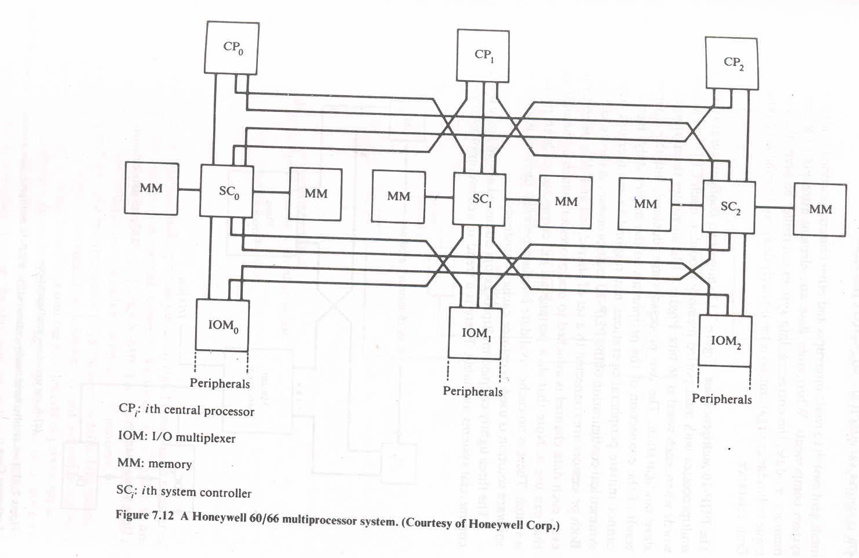
Honeywell 60/66 multiprocessor

Slide 16
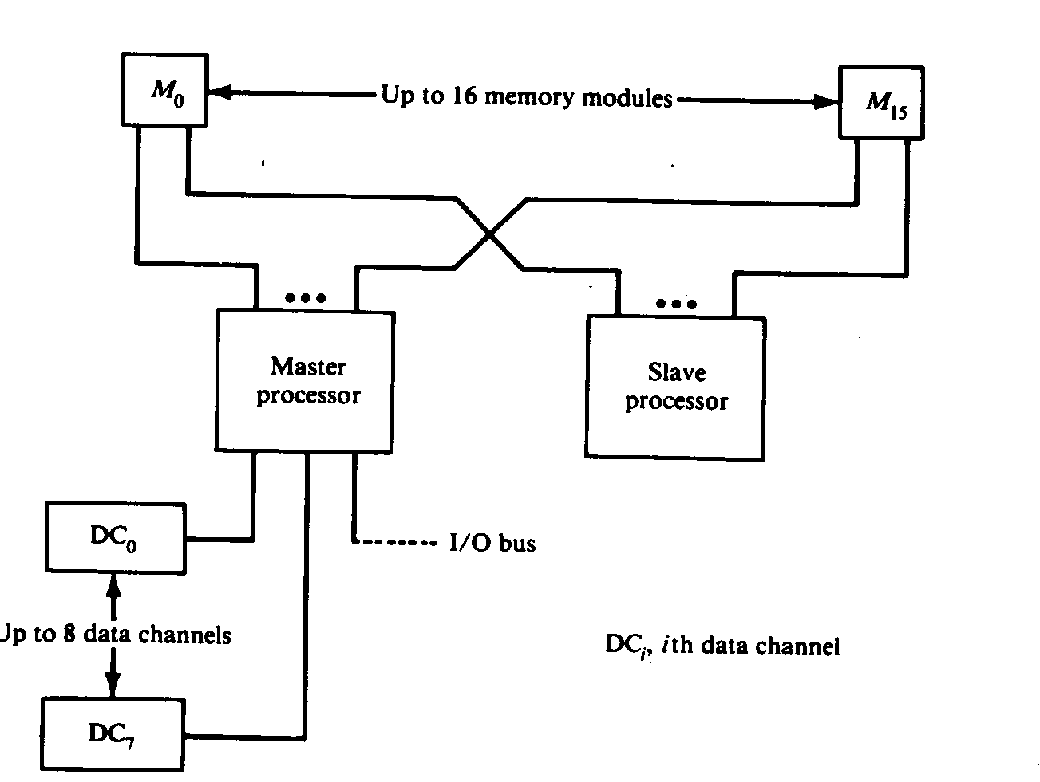
PDP-10 multiprocessor
a)A master slave configuration

Slide 17
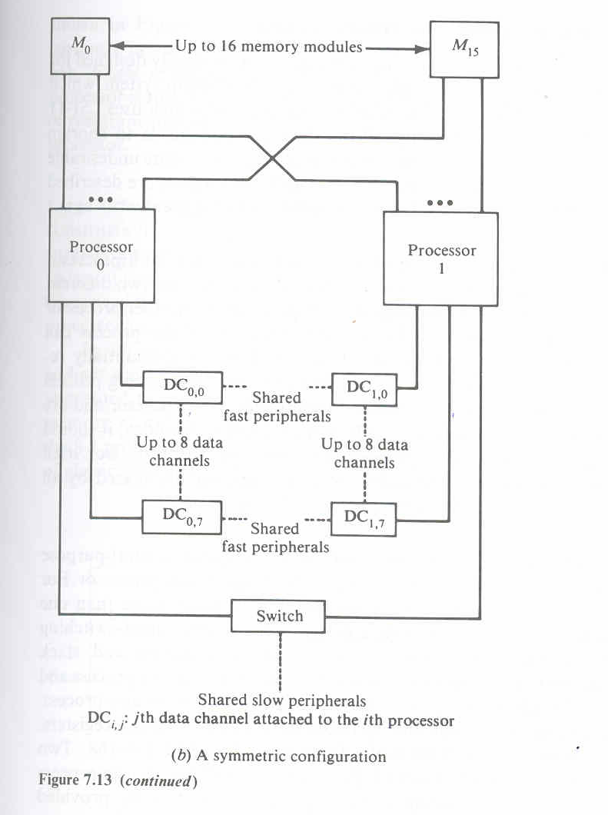
PDP-10 multiprocessor
a)A symmetric configuration

Slide 18
Time shared or common buses
I/O
processor
Memory
module
Memory
module
I/O
processor
Processor
Processor
Multiprocessor with unidirectional buses
Bus
modifier
Control
logic
Processor
Processor
Memory
units
I/O
devices
Multi-bus multiprocessor organizations
I/O0
M0
M1
M2
I/O1
P0
P1
P2

Slide 19
Device
1
Device
2
Device
m
Bus
Control
unit
Bus grant(BGT)
Bus busy(SACK)
Bus request
(BRQ)
Bus
Static daisy chain implementation of a system bus

Slide 20
Device
1
Device
2
Device
m
Partial bus controller
BGT
SACK
BRQ
Bus
Rotating daisy chain implementation of a system bus

Slide 21
Bus
Control
unit
Device
1
Device
2
Device
m
log2m
SACK
BRQ
Bus
Polling implementation of a system bus

Slide 22
Bus
Control
unit
Device
1
Device
2
Device
m
BGT1
BRQ1
BGT2
BRQ2
BGTm
BRQm
SACK
Bus

Slide 23
M0
M1
Mm-1
P0
I/O0
Pp-1
I/Od-1
Crossbar non blocking switch system organization

Slide 24
Memory
module
Mux
modules
Data
Data
RD/WR
RD/WR
From P0 to P15
addr
addr
Arbitration
module
REQ0
ACK0
Memory
enable
REQ1
ACK1
REQ15
ACK15

Slide 25
M0
M1
M2
D
D
D
P0
I/O0
D
P1
I/O1
Crossbar organization for inter processor memory I/O connection

Slide 26
P0
P1
M0
M1
M2
M3
I/O0
I/O1
Multiport-memory organization without fixed priority assignment

Slide 27
P0
P1
0 1
M0
2 3
0 1
M1
3 2
1 0
M2
2 3
1 0
M3
3 2
I/O0
I/O1
Multiport-memory organization with fixed priority assignment

Slide 28
P0
P1
M0
M1
M2
M3
I/O0
I/O1
Multiport-memory organization with private memories

Slide 29
Process 0
Language Features to Exploit Parallelism
Fork A,J,3
A
Process 0
Fork B
B
Join J
Process 1
Process 2
Join J
Join J
J
J+1
Process I
I ɛ |0,1,2|

Slide 30
Precedence graph of the concurrent program
S0
S1
S2
Sn
Sn+1

Slide 31
Precedence graph of concurrent nested process
S0
S2
S1
S3
S4
S5
S7
S6
S8

Slide 32
A1
I=0
PREP
Parfor I =1 until n do
Begin
A2
i=i+1
A3
If i>n GOTO A6
End
A4
AND( A2)
A5
BEGINS
END for i
A6
JOIN

